Slide 1

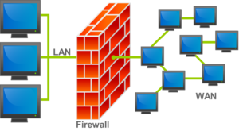
F I R E W A L L

Slide 2
FIREWALL
As the name implies, a firewall acts to provide secured access between two networks
A firewall may be implemented as a standalone hardware device or in the form of a software on a client computer or a proxy server

Slide 3
Mode of operation
Stands in between two networks will inspect a packet that is ready to pass between the networks and allow or block the packet based on the rules set for the firewall to operate

Slide 4
General Firewall Features
Port Control
Network Address Translation
Application Monitoring (Program Control)
Packet Filtering
Data encryption
e-mail virus protection
Pop-up ad blocking
Spy ware protection etc.

Slide 5
Types of Firewalls
1.Packet Filtering
2.Application Level Gateway
3.Circut Level Gateway

Slide 6
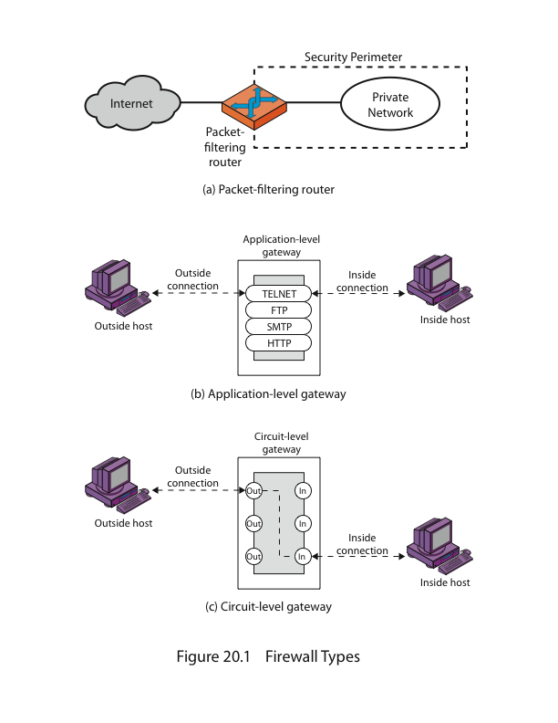

Slide 7
Packet Filtering
Simplest of components
Filtering with incoming or outgoing interfaces
Permits or denies certain services
Filtering rules are based on the information contained in a network packet

Slide 8
Packet Information
1.Source IP Address
2.Destination IP Address
3.Source and Destination transport level address
4.IP protocol field
5.Port Address

Slide 9
Packet Filtering
Also known as Network layer firewalls
Packet filtering firewalls work mainly on the first three layers of the OSI reference model.
When a packet originates from the sender and filters through a firewall, the device checks for matches to any of the packet filtering rules that are configured in the firewall and drops or rejects the packet accordingly.
Two sub-categories, stateful and stateless.

Slide 10
Disadvantages
1. Does not support advanced user authentication
2. Vulnerable to attacks

Slide 11
Attacks
1. IP Address Spoofing
2. Source routing attacks
3. Tiny fragment attacks

Slide 12
THANK YOU…

